Slide 1

Note: the font is smaller than usual here so it fits nicely.
Setting up your optimization problem
Numerical approximation
of gradients
deeplearning.ai

Slide 2
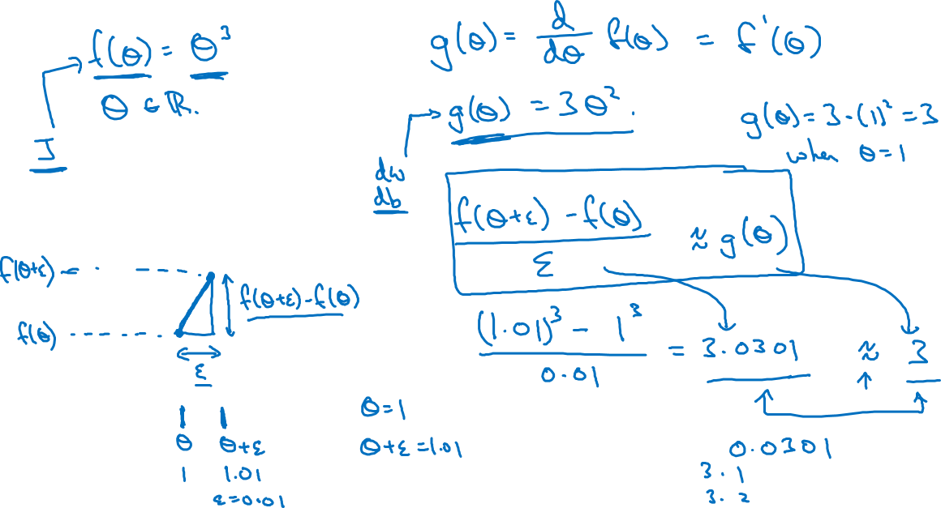

Checking your derivative computation
$$f$$

Slide 3
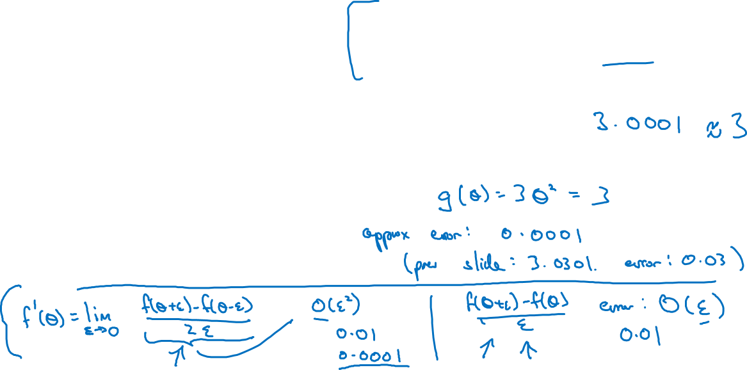
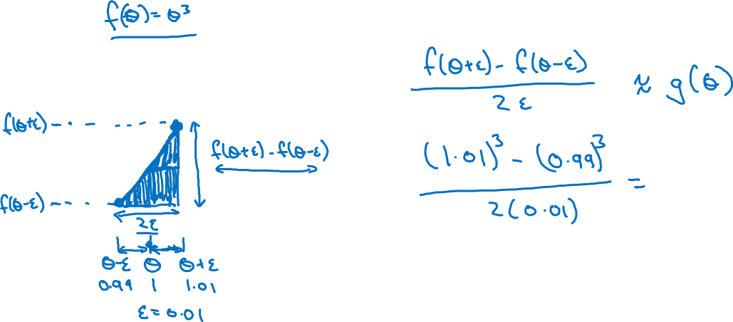
Checking your derivative computation
$$f$$

